Slide 1
More open or closed? Smarter or dumber?
Siyao Zhang G142439
How the internet shapes our thinking？
Siyao Zhang (coco) G142439

Slide 2
Table of contents
01
02
03
04
Siyao Zhang G142439
Introduction
information cocoons created by algorithmic personalization
Background
Has the Internet made us more open or closed? Smarter or dumber? Deeper or shallower?
Problem Analysis
Causes of Information Cocoons and effects of Information Cocoons
Solution Evaluation
Enhancing User Media Literacy and optimizing Algorithms

Slide 3
01
Introduction
Siyao Zhang G142439
information cocoons created by algorithmic personalization

Slide 4
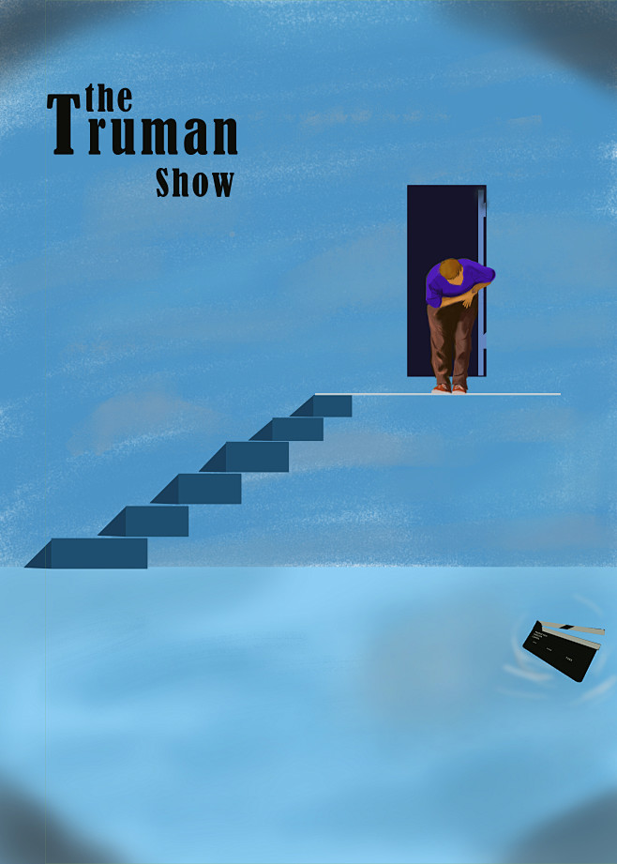


Introduction
Siyao Zhang G142439

Slide 5
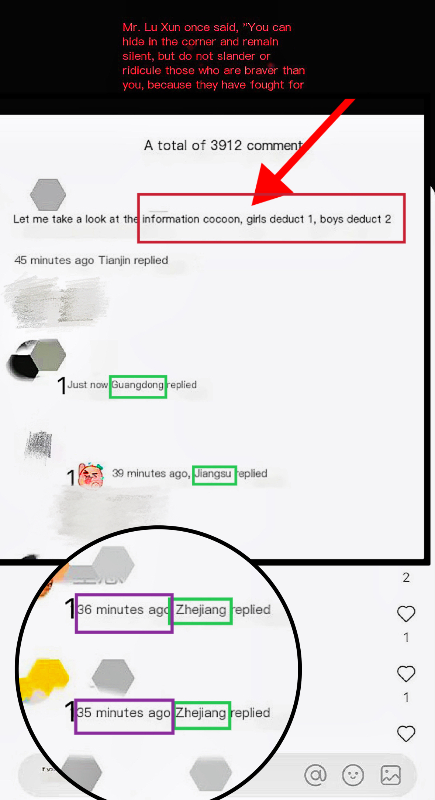
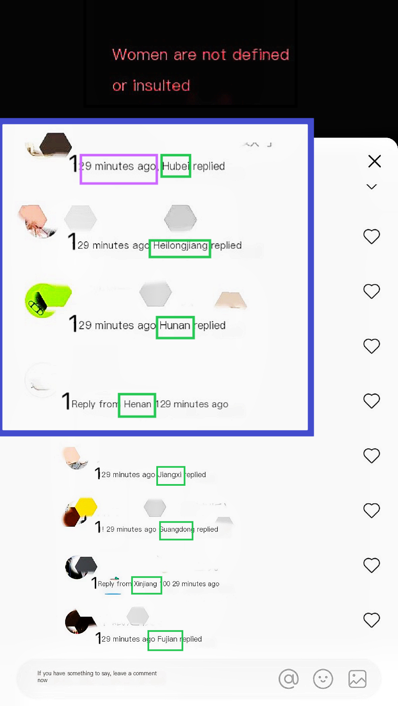
Siyao Zhang G142439
The information cocoon of social media in real life
women are not defined or insulted
Let me take a look at the information cocoon, girls reply 1, boys reply 2.

Slide 6
02
Background
Siyao Zhang G142439
Open or closed? Smarter or dumber?

Slide 7

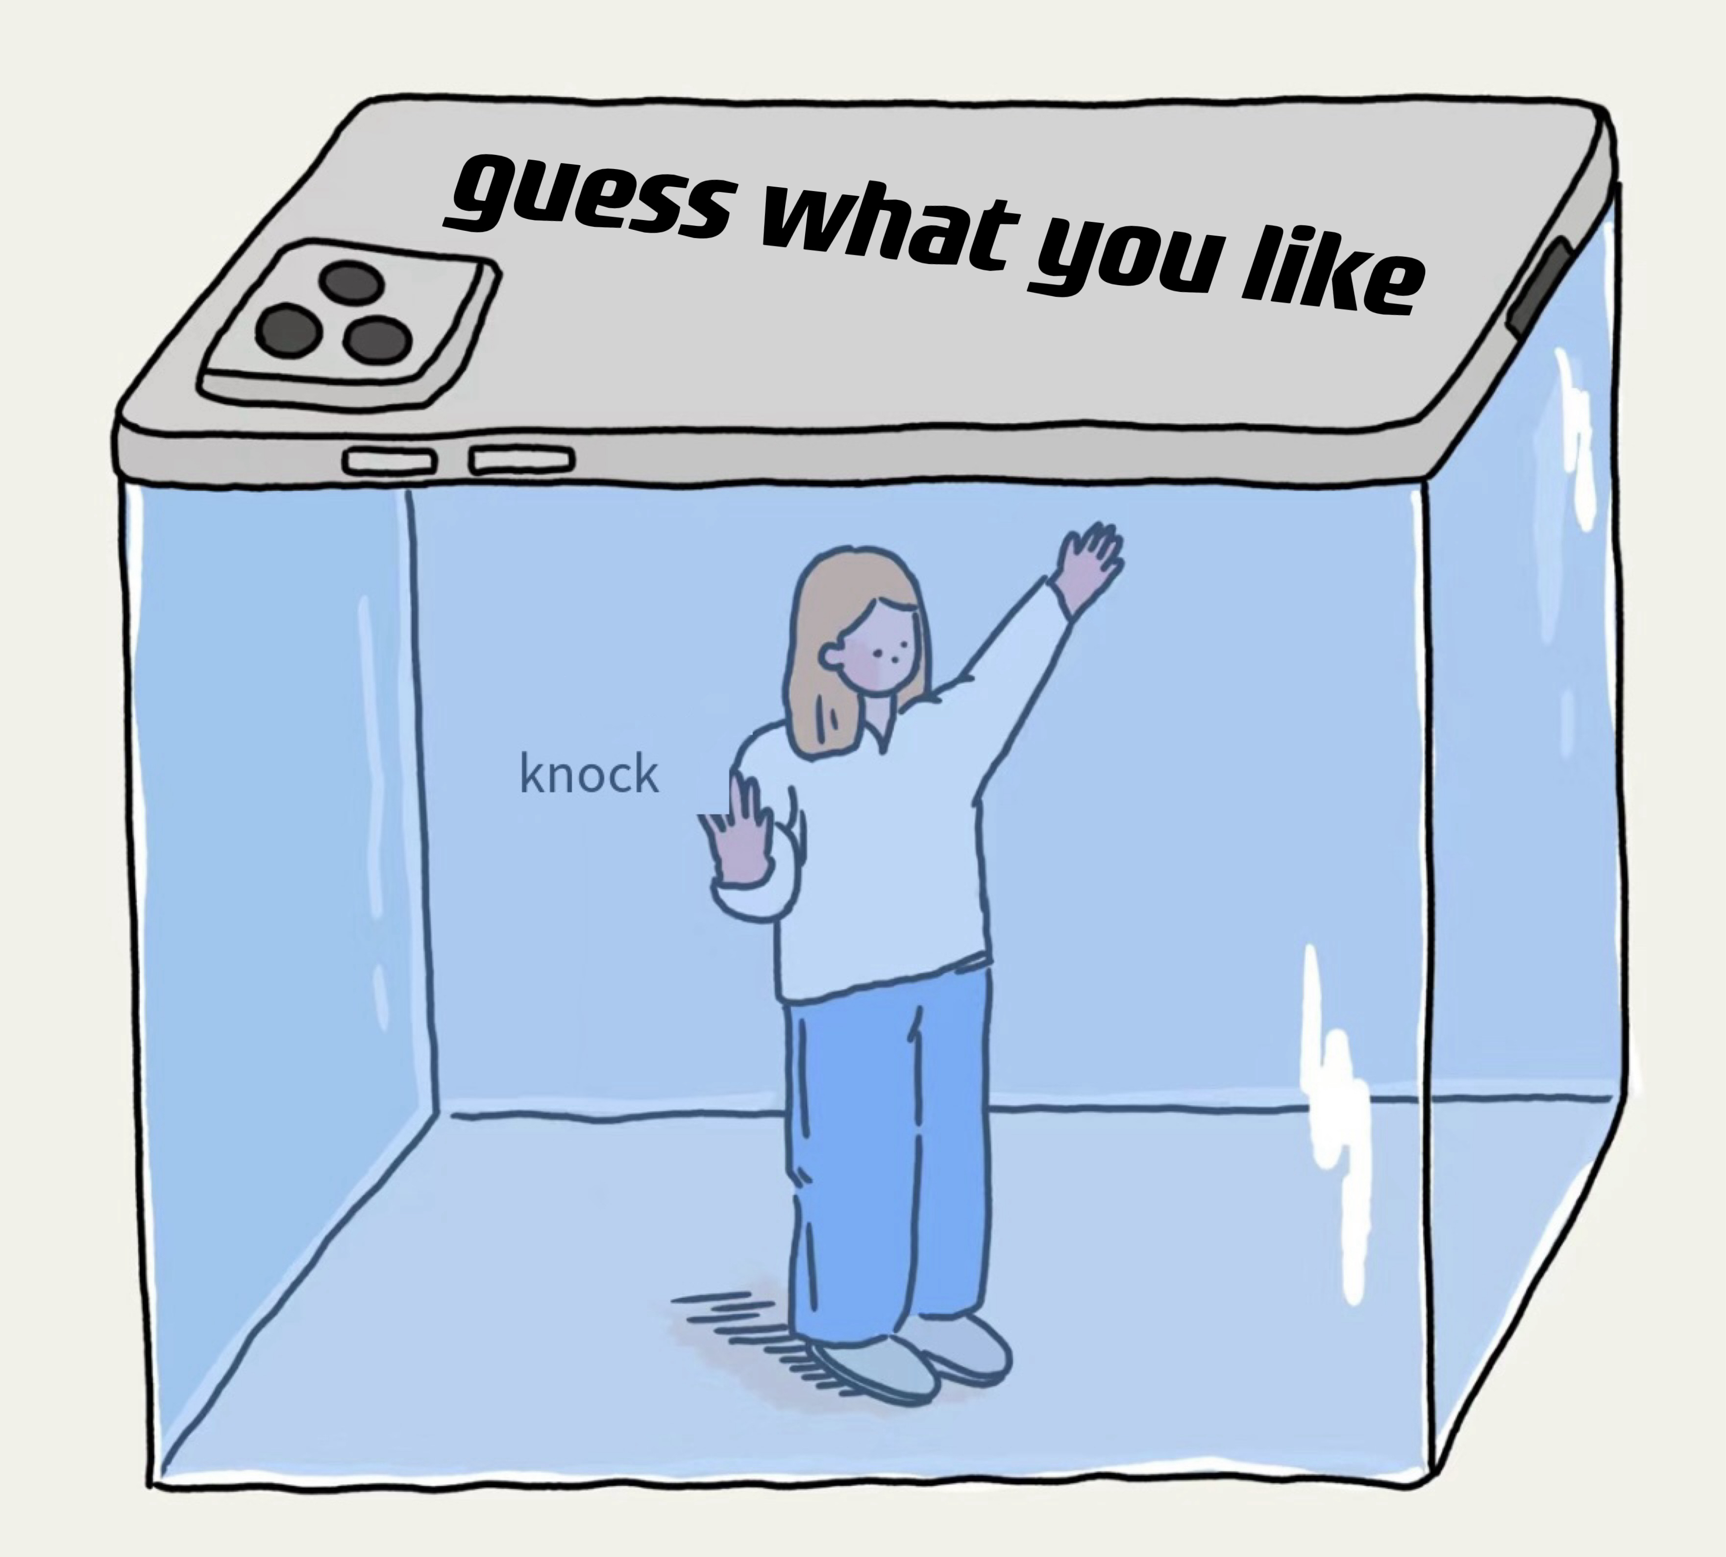
The Truman Show & Information cocoon
Siyao Zhang G142439

Slide 8
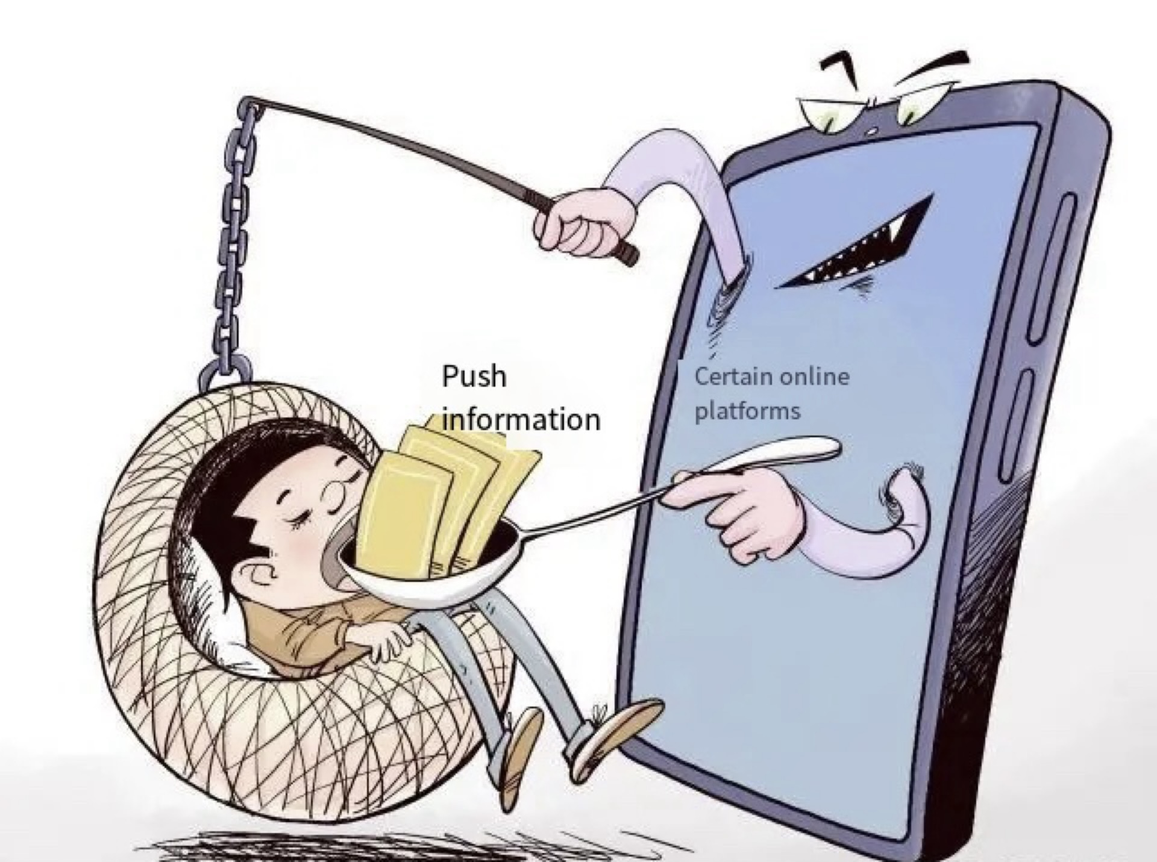
information cocoon
Siyao Zhang G142439
Definition
Information cocoons refer to the phenomenon where individuals are trapped within their own informational bubble, only exposed to information that aligns with their pre-existing beliefs.

Slide 9
03
Problem Analysis
Siyao Zhang G142439
Causes and effects

Slide 10
Causes of Information Cocoons
Siyao Zhang G142439
Algorithmic personalization
User behavior
Information homogeneity
Algorithms like collaborative filtering and content-based recommendations tailor content to user preferences (Li et al., 2023)
Users tend to select information that aligns with their interests, reinforced by platforms focusing on user experience (Wang, 2023)
On platforms like TikTok, personalized recommendations lead to users encountering similar types of content repeatedly (Wang & Zhang, 2023)

Slide 11
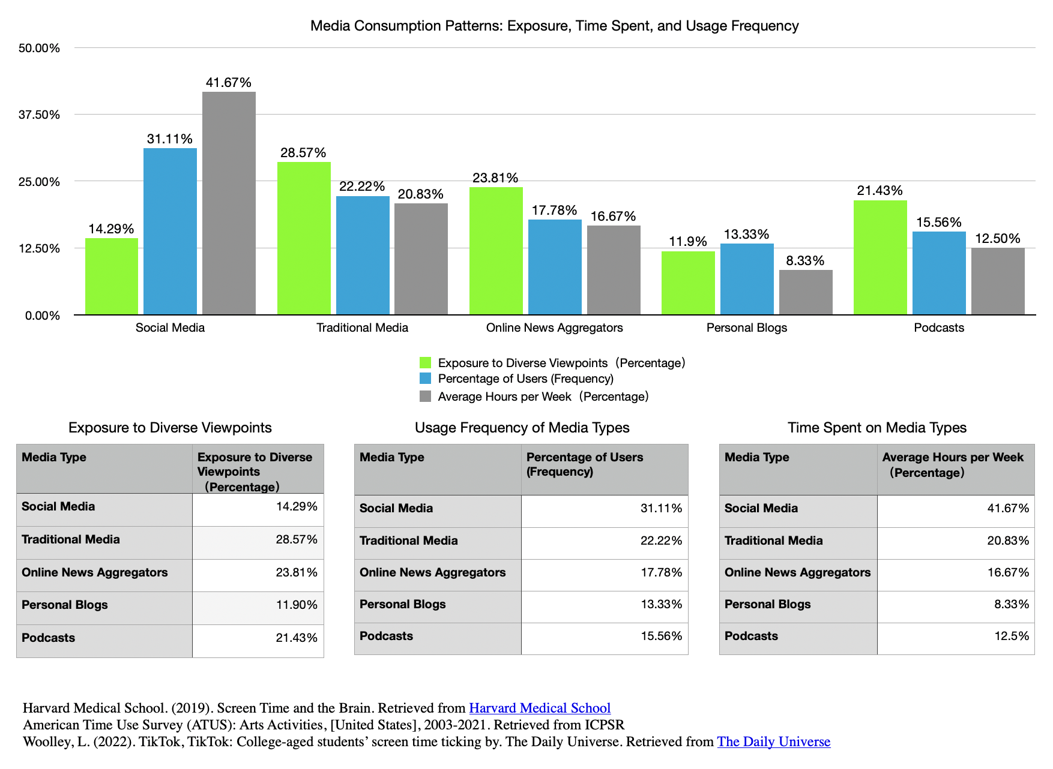
Siyao Zhang G142439
Exposure to Diverse Viewpoints (Percentage)
Percentage of Users (Frequency)
Average Hours per Week (Percentage)

Slide 12
Effects of Information Cocoons
2.Information anxiety and weakened deep thinking:
1.Cognitive imbalance：
Users are only exposed to a narrow range of information, which can lead to a skewed perception of reality (Wang, 2023).
Constant exposure to similar information can lead to anxiety and reduced critical thinking skills (Wang & Zhang, 2023).
3.Group polarization:
Homogeneous information environments reinforce existing beliefs, leading to polarized groups (Li et al., 2023).
Siyao Zhang G142439

Slide 13
04
Solution Evaluation
Siyao Zhang G142439
Enhancing User Media Literacy and optimizing Algorithms

Slide 14

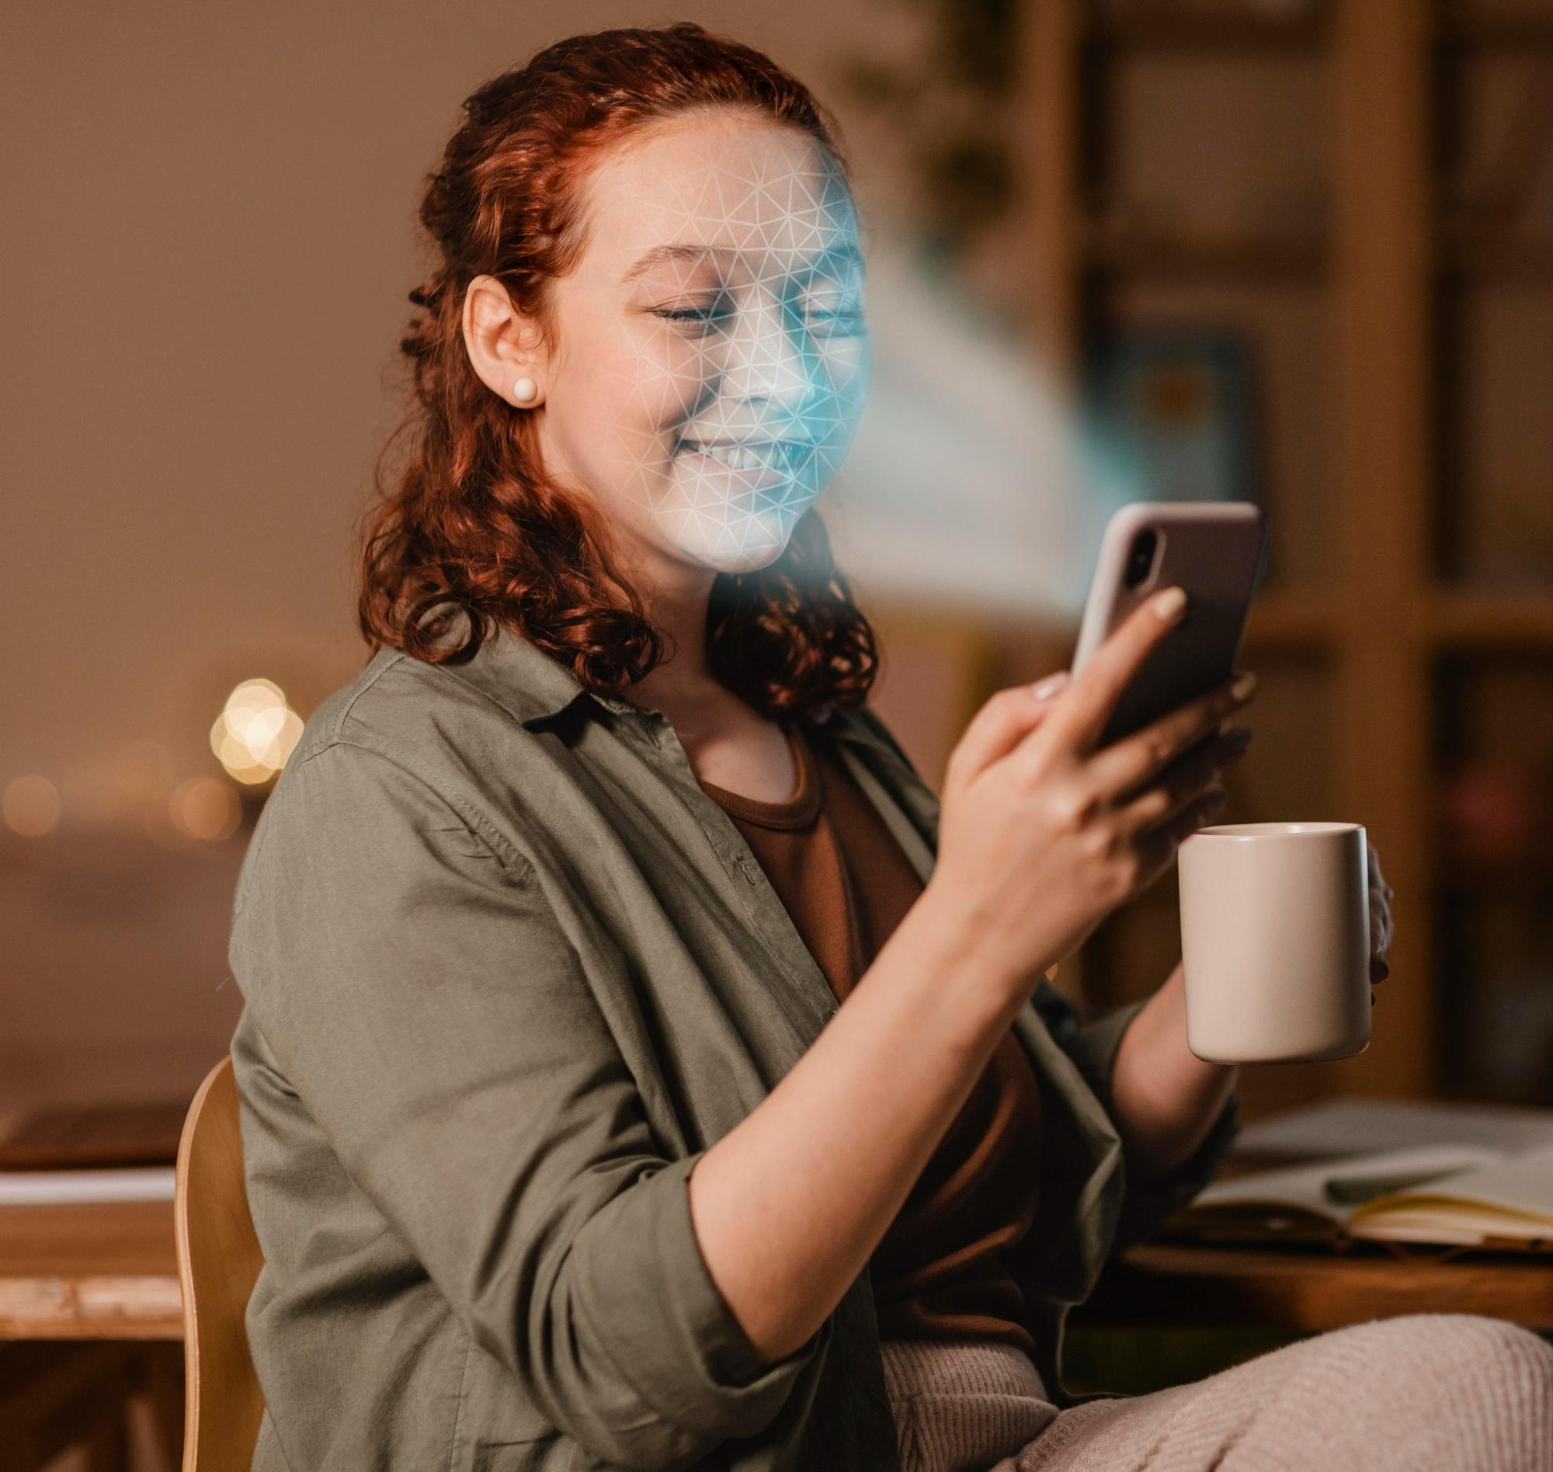

Solution Evaluation
Siyao Zhang G142439
Platform Responsibilities
Optimizing Algorithms
Enhancing User Media Literacy
Platforms should balance personalized content with public interest information to promote social cohesion (Wang, 2023).
Platforms should also take responsibility for debunking misinformation and promoting accurate content (Li et al., 2023).
Developing algorithms that not only cater to user preferences but also introduce diverse content to broaden users’ perspectives (Wang & Zhang, 2023).
Implementing features that periodically suggest content from different viewpoints (Li et al., 2023).
Educating users about the risks of information cocoons and encouraging them to seek diverse information sources (Li et al., 2023).
Encouraging users to actively engage with content outside their comfort zones (Wang, 2023).

Slide 15

Conclusion
Siyao Zhang G142439
In conclusion, the information cocoon effect is a significant issue exacerbated by algorithmic personalization on social media platforms. By enhancing user media literacy, optimizing recommendation algorithms, and encouraging platforms to take responsibility, we can mitigate the negative impacts of information cocoons.

Slide 16

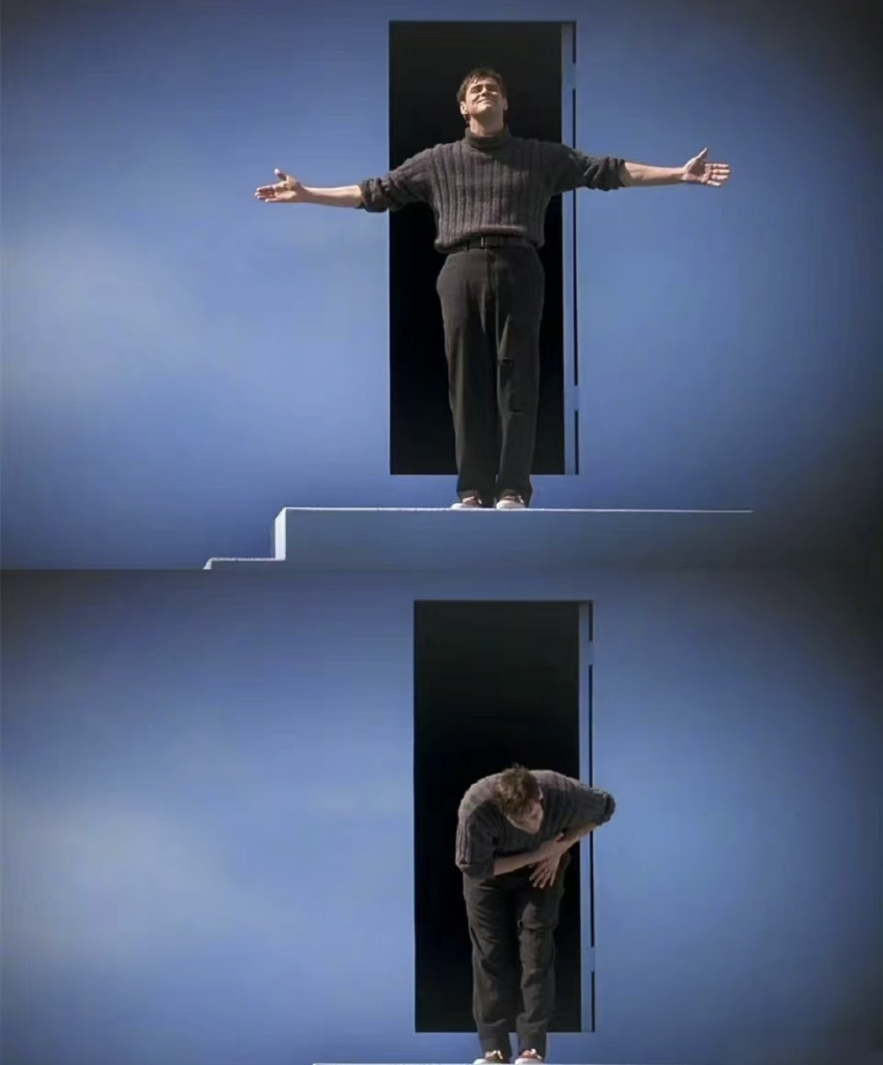
Siyao Zhang G142439

Slide 17
Resources
Siyao Zhang G142439
Li, T., Dong, Y. and Zhang, B., 2023, June. Algorithm based personalized push Research on" Information Cocoon Room". In 2023 8th International Conference on Information Systems Engineering (ICISE) (pp. 286-289). IEEE, accessed 21 July 2024, <https://ieeexplore.ieee.org/abstract/document/10314387>.
Wang, J. and Zhang, R., 2022, August. Research on the influencing factors of the user information cocoon effect of short video platforms based on personalized recommendation algorithms. In 2022 2nd International Conference on Big Data Engineering and Education (BDEE) (pp. 53-60). IEEE, accessed 21 July 2024, <https://ieeexplore.ieee.org/abstract/document/9980881>.
Yi, W., 2023. An Analysis of the Information Cocoon Effect of News Clients: Today's Headlines as an Example. The Frontiers of Society, Science and Technology, 5(9), accessed 21 July 2024, <https://francis-press.com/papers/11263>.

Slide 18
Thanks!
Siyao Zhang G142439
Do you have any questions?

